Slide 1


Hanoi University
MEAL
APP
Presentation by
Hai Pham

Slide 2

Introduction
4 screens:
CategoriesScreen
MealListScreen
FavoriteMealScreen
MealList Screen
1

Slide 3
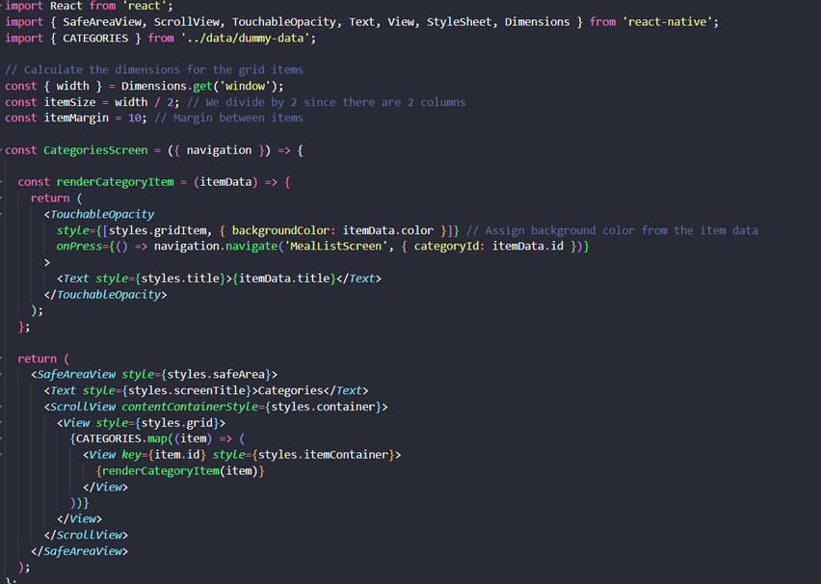
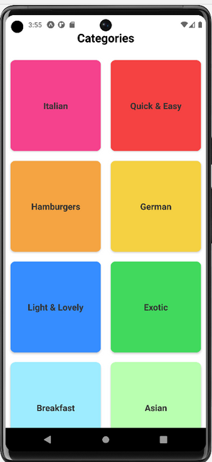
CategoriesScreen
set up by adding built-in component and import packages
CategoriesScreen after adding some styles and details
Hai Pham

Slide 4
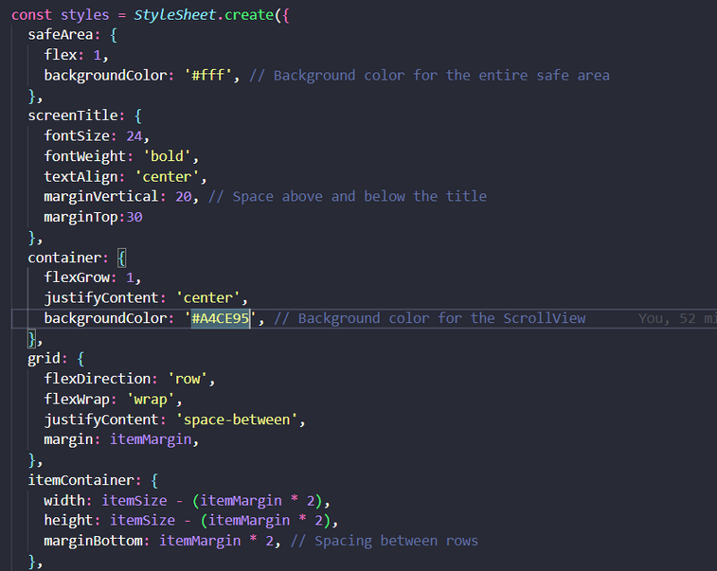
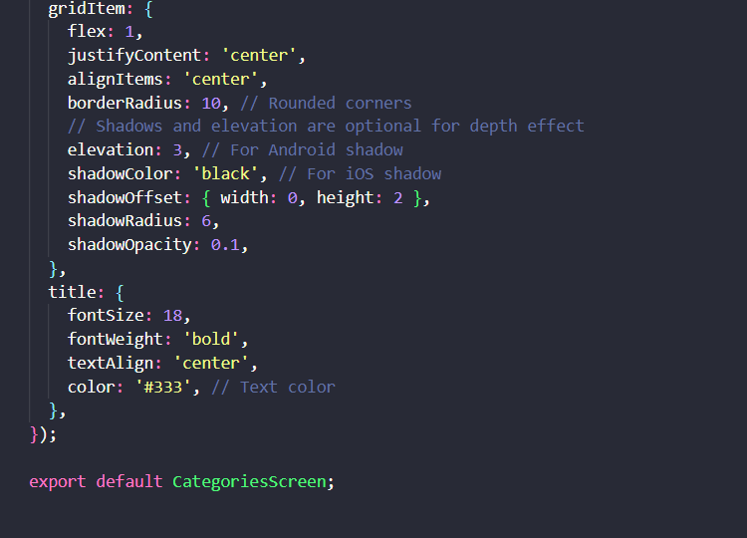
Adding some styles to CategoriesScreen
Hai Pham
4

Slide 5
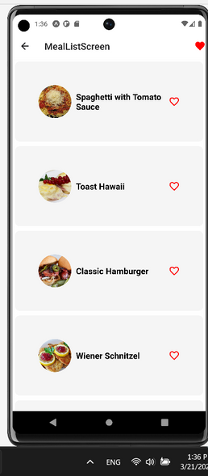
MealListScreen
MealListScreen after completing all setup and style
Hai Pham

Slide 6
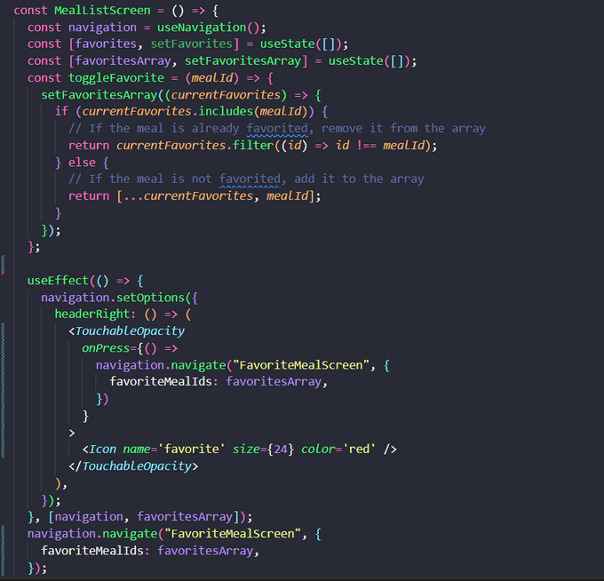
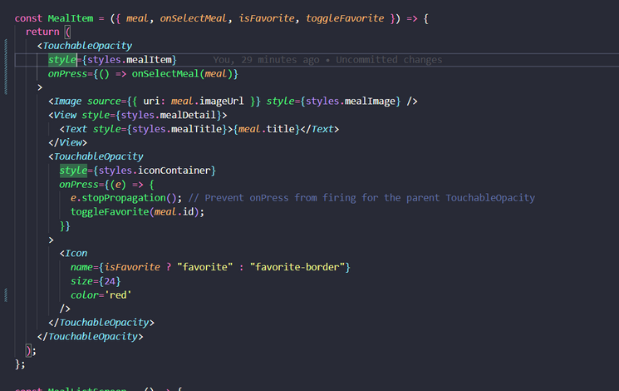
MealListScreen
Set up MealItem
Set up MealListScreen
Hai Pham

Slide 7
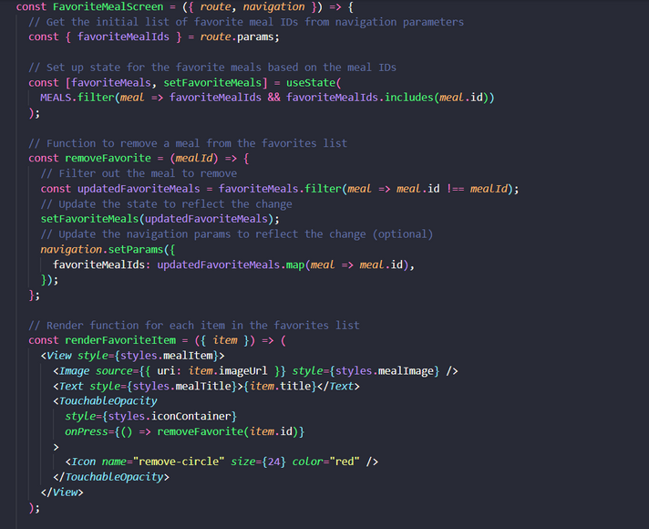
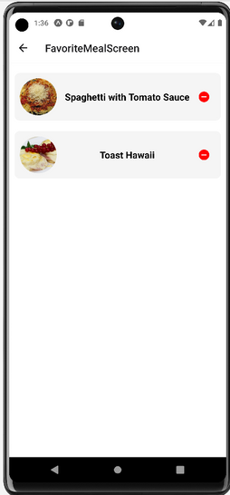
FavoriteMealScreen
set up by adding built-in component and import packages
CategoriesScreen after adding some styles and details
Hai Pham

Slide 8
FavoriteMealScreen
adding styles to FavoriteMealScreen
Hai Pham

Slide 9
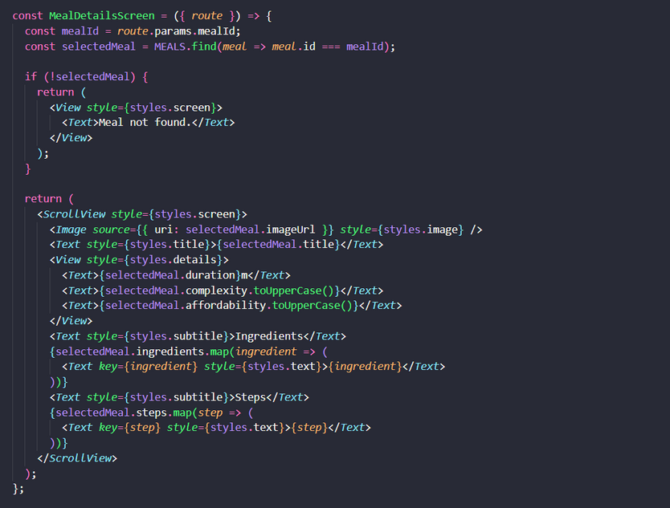
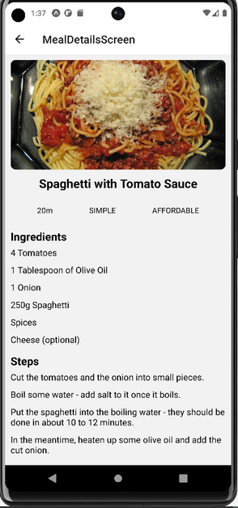
MealDetailsScreen
set up MealDetailScreen
MealDetailsScreen after completing
Hai Pham

Slide 10
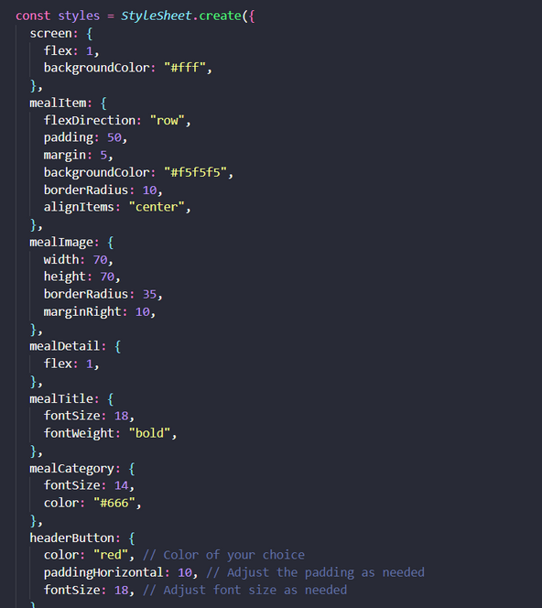
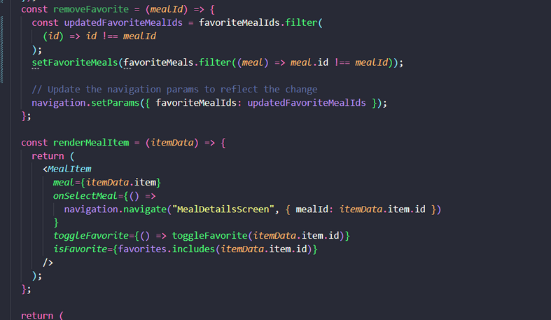
MealListScreen
Set up removeMealItem
adding some styles
Hai Pham

Slide 11
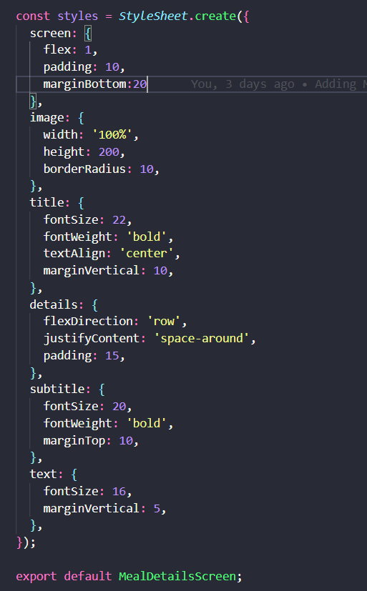
MealListScreen
Adding some styles
Hai Pham

Slide 12

Hanoi University
THANK YOU FOR VIEWING SLIDES

